Slide 1
Deep Learning with PyTorch Training a classification model to detect suspected tumors
孙越凡
2020.09.30

Slide 2

目录
11.1 A foundational model and training loop
11.2 The main entry point for our application
11.3 Pretraining setup and initialization
11.4 Our first-pass neural network design
11.5 Training and validating the model
11.6 Outputting performance metrics
11.7 Running the training script
11.8 Evaluating the model: Getting 99.7% correct means we are done, right?
（11.9） Graphing training metrics with TensorBoard
11.10 Why isn’t the model learning to detect nodules?
11.11 Conclusion
11.12 Exercises
11.13 Summary
前言
模型设计
模型评估
总结

Slide 3
前言
We will classify candidates as nodules or non-nodules.That means we’re going to assign a single, specific label to each sample that we present to the model.

Slide 4
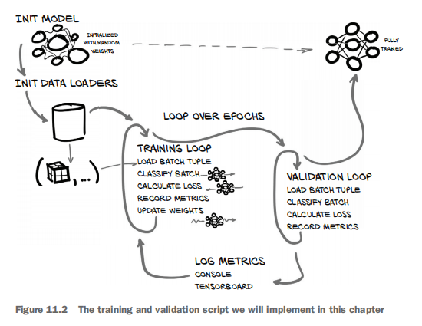
前言

Slide 5
前言
The data-loader worker process loads the relevant batch of data in the background.

Slide 6
模型设计
11.3 Pretraining setup and initialization
11.4 Our first-pass neural network design
11.5 Training and validating the model
11.6 Outputting performance metrics

Slide 7
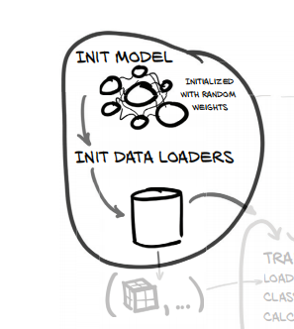
Pretraining setup and initialization
initialize our model and optimizer

Slide 8
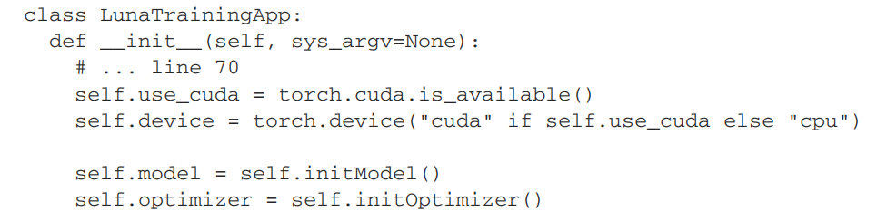
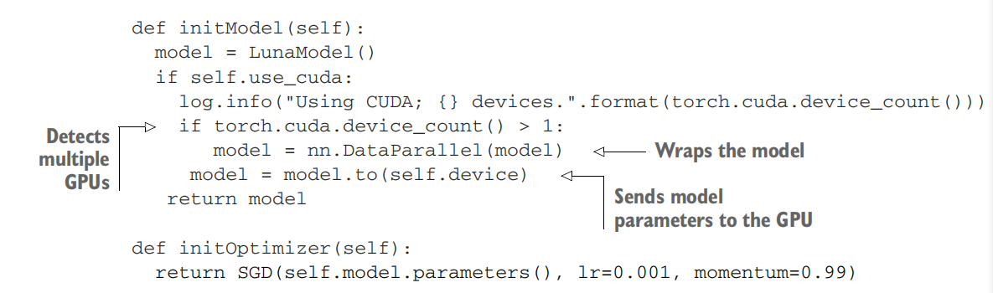
Pretraining setup and initialization

Slide 9
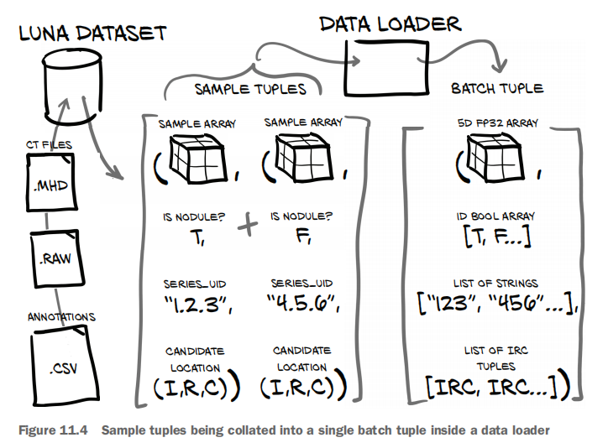
Pretraining setup and initialization

Slide 10
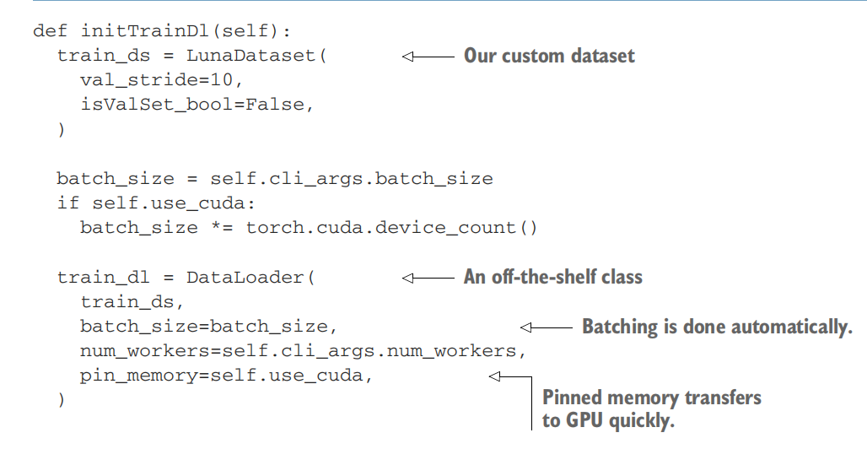
Pretraining setup and initialization

Slide 11
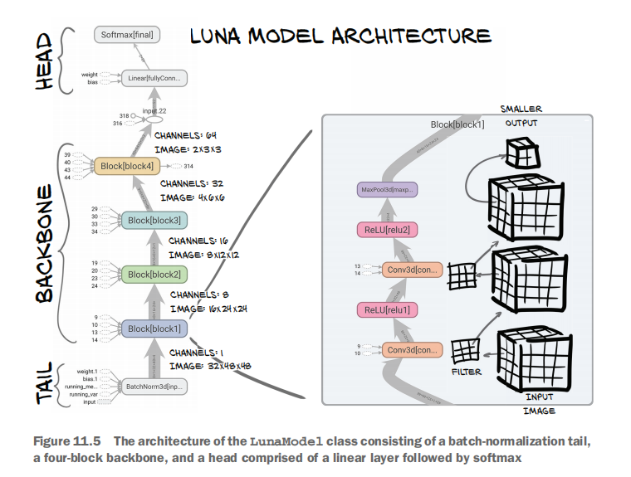
First-pass neural network design

Slide 12
First-pass neural network design
The tail is the first few layers that process the input to the network. It adapt the input to the form expected by the backbone.
首先，在进行训练之前，一般要对数据做归一化，使其分布一致，但是在深度神经网络训练过程中，通常以送入网络的每一个batch训练，这样每个batch具有不同的分布；而且在训练过程中，数据分布会发生变化，对下一层网络的学习带来困难。

Slide 13
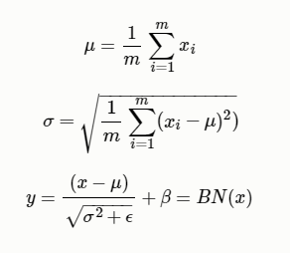
First-pass neural network design
batch normalization (批处理归一化）
将数据拉回到均值为0，方差为1的正太分布上，这样不仅数据分布一致，而且避免发生梯度消失

Slide 14
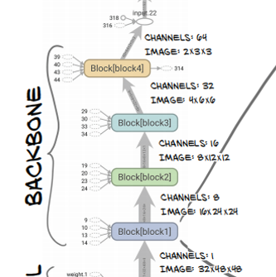
First-pass neural network design

Slide 15
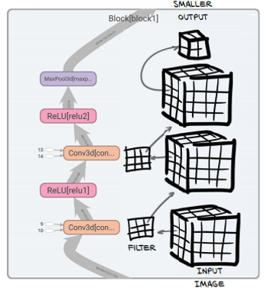
First-pass neural network design
We will use a block that consists of two 3 × 3 convolutions, each followed by an activation, with a max-pooling operation at the end of the block.

Slide 16
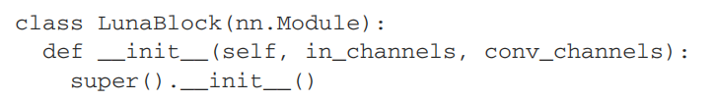
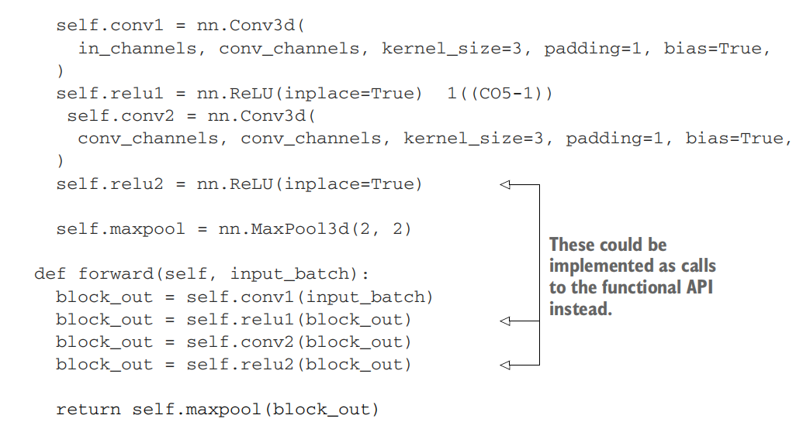
First-pass neural network design

Slide 17

First-pass neural network design
Finally, the head of the network takes the output from the backbone and converts it into the desired output form.

Slide 18
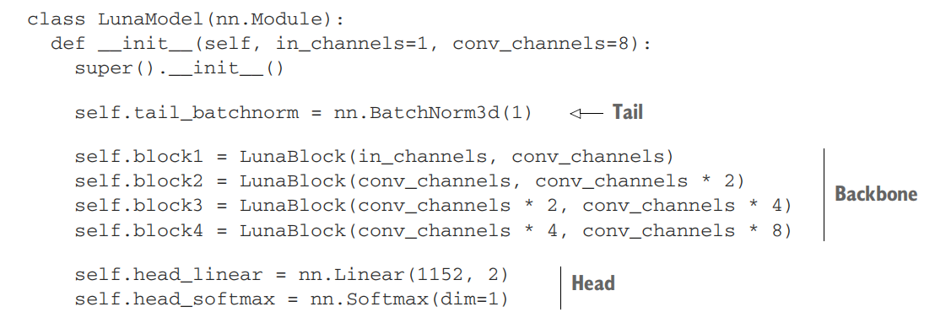
First-pass neural network design

Slide 19
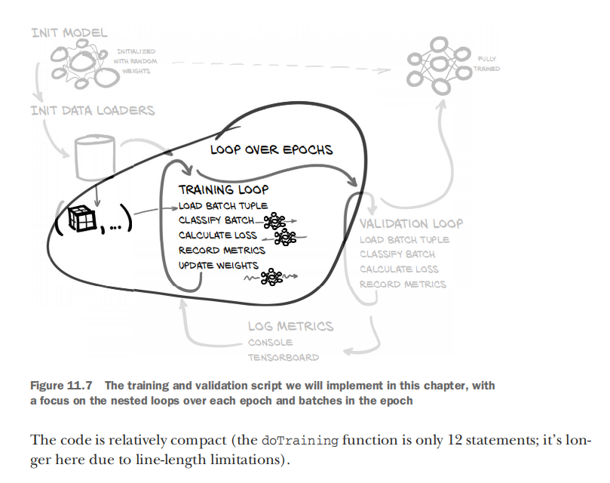
Training and validating the model

Slide 20
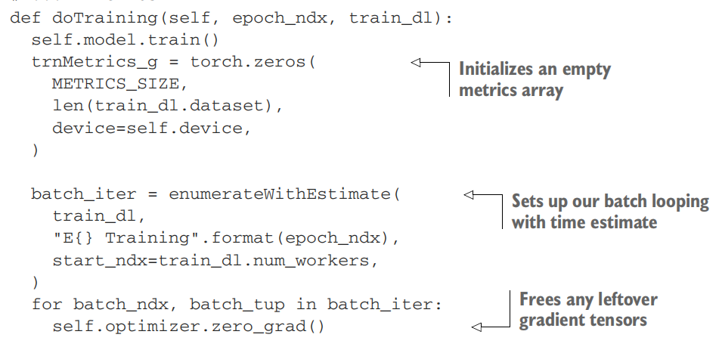
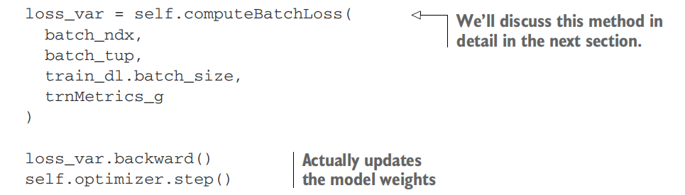
Training and validating the model

Slide 21
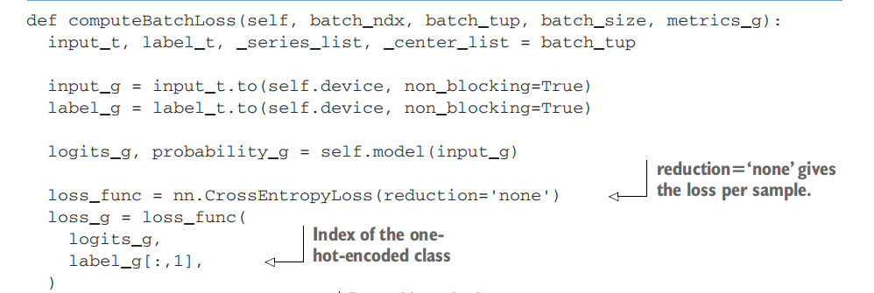
Training and validating the model

Slide 22
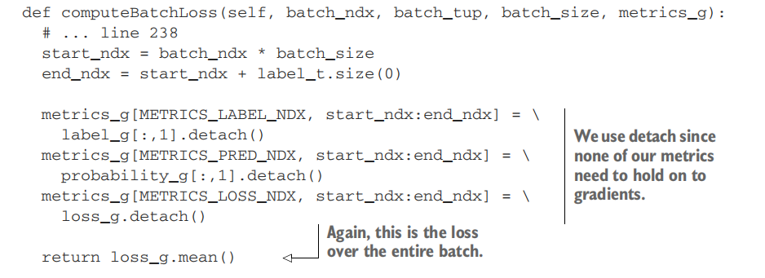
Training and validating the model

Slide 23
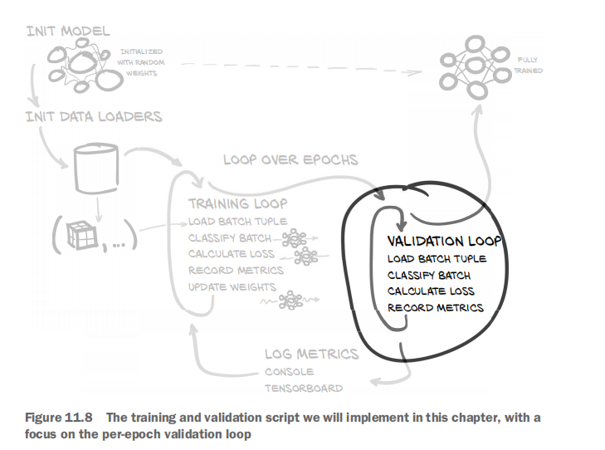
Training and validating the model

Slide 24
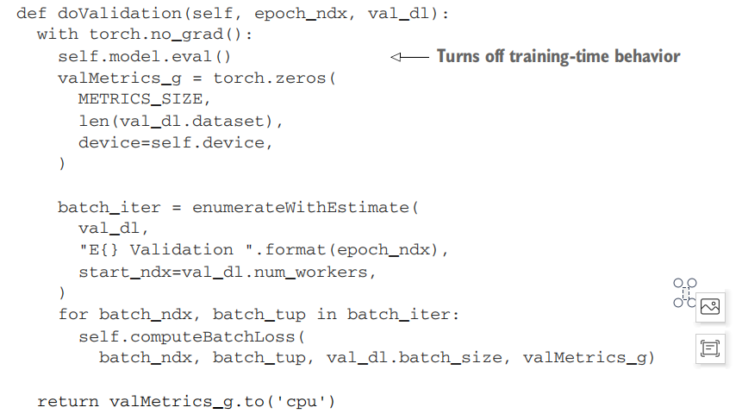
Training and validating the model
尽管我们并未将computeBatchLoss返回的整体每批次损失用于任何情况，但仍在调用valMetrics_g中收集度量标准。

Slide 25
Training and validating the model
The last thing we do per epoch is log our performance metrics for this epoch.

Slide 26
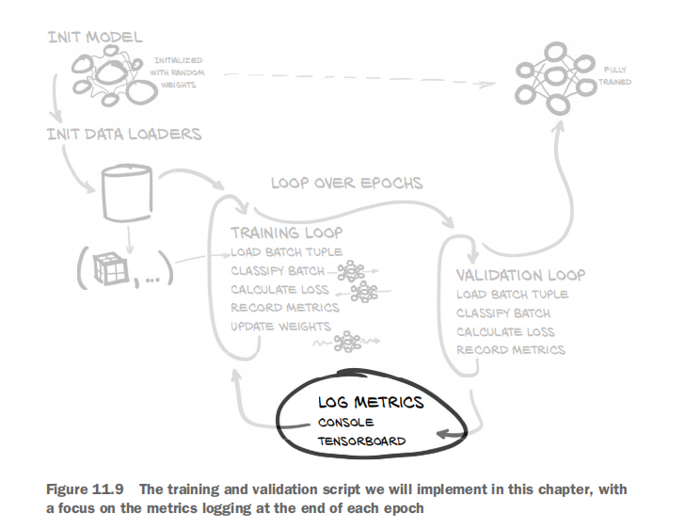
Training and validating the model
trnMetrics_g
valMetrics_g

Slide 27
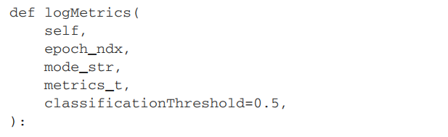
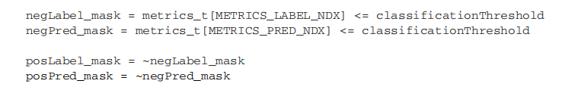
Training and validating the model

Slide 28
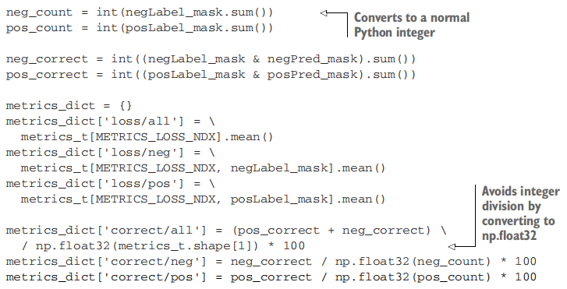
Training and validating the model

Slide 29
模型评估
11.7 Running the training script
11.8 Evaluating the model: Getting 99.7% correct means we are done, right?
11.10 Why isn’t the model learning to detect nodules?

Slide 30
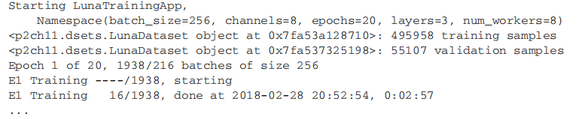
Running the training script

Slide 31
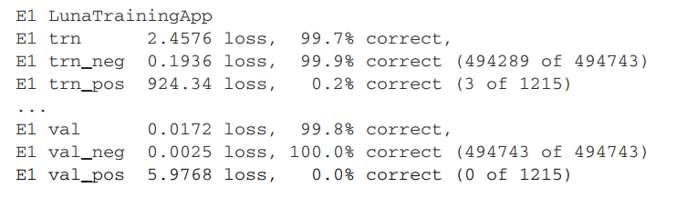
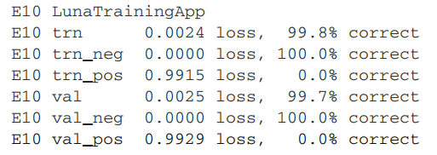
Running the training script

Slide 32
Evaluating the model
both the training and validation set show at least 99.7% correct results. That’s an A+!
We just solved cancer! … Right?
none of the nodule samples are correctly identified.

Slide 33
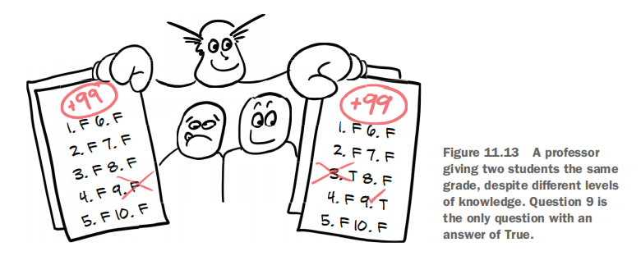
Evaluating the model
Our model is clearly learning something— the loss on the training
and validation sets is decreasing, and the results are repeatable.
There is a disconnect, however, between what the model is learning and what we want it to learn.

Slide 34
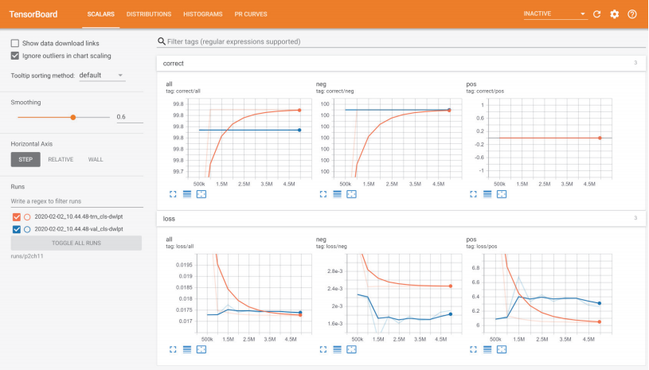
TensorBoard
TensorBoard：a quick and easy way to get our training metrics out of our training loop and into some pretty graphs.
https://tensorflow.google.cn/tensorboard?hl=zh-cn

Slide 35
Summary
We now have a model and a training loop, and are able to consume the data we produced in the last chapter.
Data loaders can be used to load data from arbitrary datasets in multiple processes.
Data loaders load multiple samples from a dataset and collate them into a batch.
Our initial model for classification will be very similar to the model we used inchapter 8.
We will use PyTorch’s torch.optim.SGD optimizer with a learning rate of 0.001 and a momentum of 0.99 for the majority of part 2.

Slide 36
Summary
The choice of metrics that we monitor during training is important. Chapter 12 will detail how to evaluate and choose better metrics.
TensorBoard can be used to display a wide range of metrics visually. This makes it much easier to consume certain forms of information .

Slide 37
谢谢大家

